Slide 1

SUPERSTORE SALES DATA ANALYSIS
-Using python libraries
NITHES KUMAR M

Slide 2
1.INTRODUCTION
1.1 WHAT IS A SUPERSTORE SALES DATA ANALYSIS :
Superstore Sales Data Analysis is the process of examining and interpreting sales data from a large-scale retail store to uncover patterns, trends, and insights that can inform business decisions. By analyzing various aspects of sales data, such as product performance, customer behavior, sales trends, and geographical distribution, businesses can optimize their operations, improve profitability, and enhance customer satisfaction.

Slide 3
2.Key Components of a Superstore Sales Data Analysis
Data Collection: Gathering relevant sales data from various sources like point-of-sale systems, customer databases, and inventory management systems.
Data Cleaning: Ensuring data accuracy and consistency by removing errors, inconsistencies, and duplicates.
Data Exploration: Discovering initial patterns and relationships within the data through statistical summaries and visualizations.
Data Analysis: Applying statistical techniques and data mining methods to extract meaningful insights and answer specific business questions.
Data Visualization: Creating visual representations of data to communicate findings effectively to stakeholders.

Slide 4
3.Common Analysis Areas
Customer Segmentation: Grouping customers based on demographics, purchasing behavior, or other criteria to understand their preferences.
Sales Trends: Analyzing sales patterns over time to identify seasonal fluctuations, growth opportunities, and potential challenges.
Customer Behavior: Understanding customer purchasing habits, loyalty, and customer lifetime value.

Slide 5
4. Benefits of Superstore Sales Data Analysis
Improved Decision Making: Data-driven insights support informed decisions across various departments.
Enhanced Customer Experience: Better understanding customer needs and preferences leads to improved customer satisfaction.
Increased Profitability: Identifying opportunities to optimize pricing, promotions, and inventory management.
Efficient Operations: Streamlining processes and resource allocation based on data-driven insights.

Slide 6
5.Use a pandas
import a python libraries pandas,numpy and matplotlib.
import a data set read a csv file.
checking for shape of data.
calculating no of null values.
changing a float to integer.
Data Description.
Remove a duplicates.
types of customers.
numbers of customers.

Slide 7
6. import a python libraries
1.Import a python libraries :
python pandas.
numpy.
matplotlib.

Slide 8
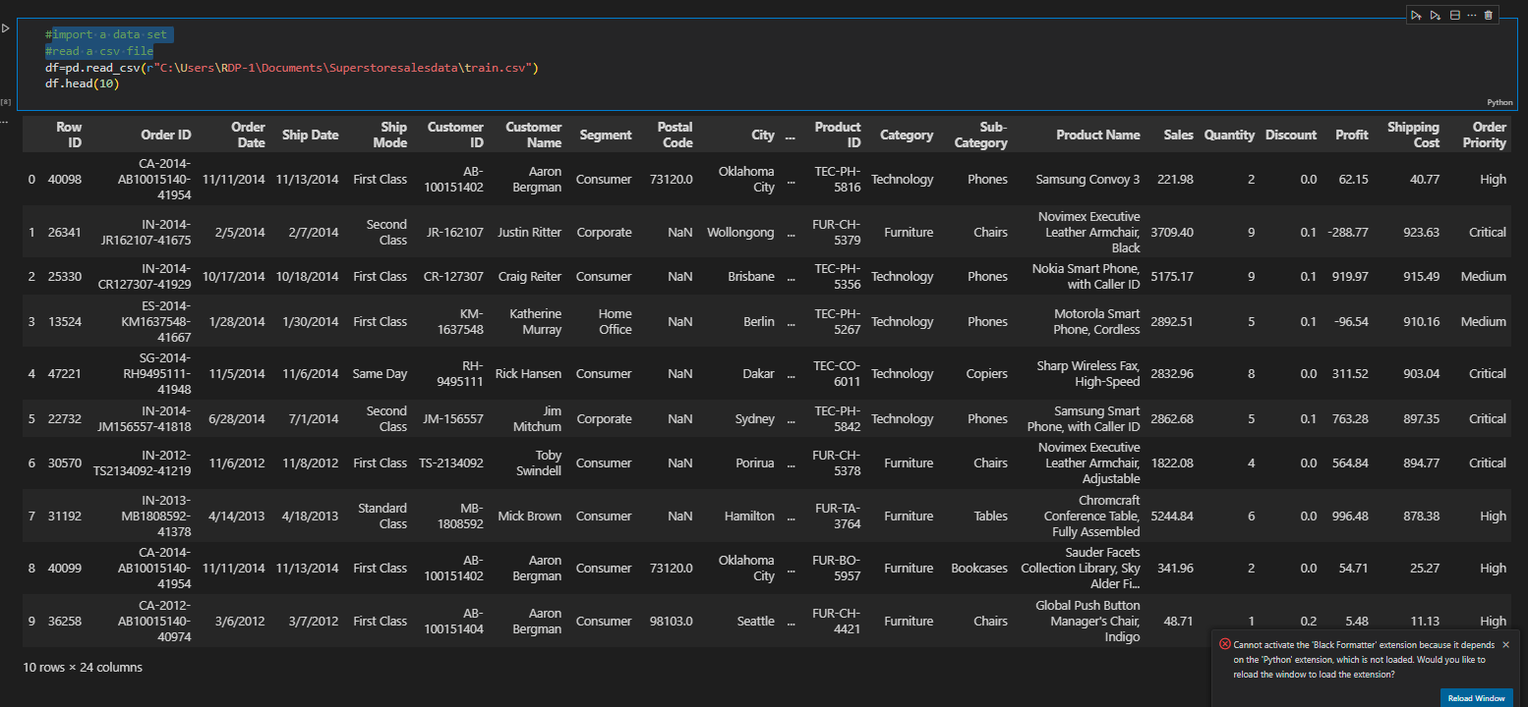
7. import a data set read a csv file

Slide 9
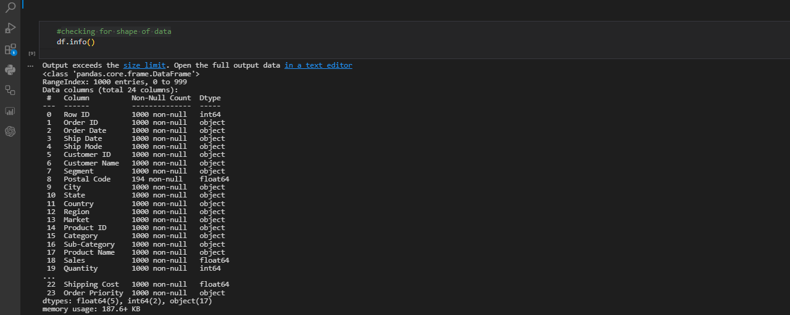
8. checking for shape of data:

Slide 10
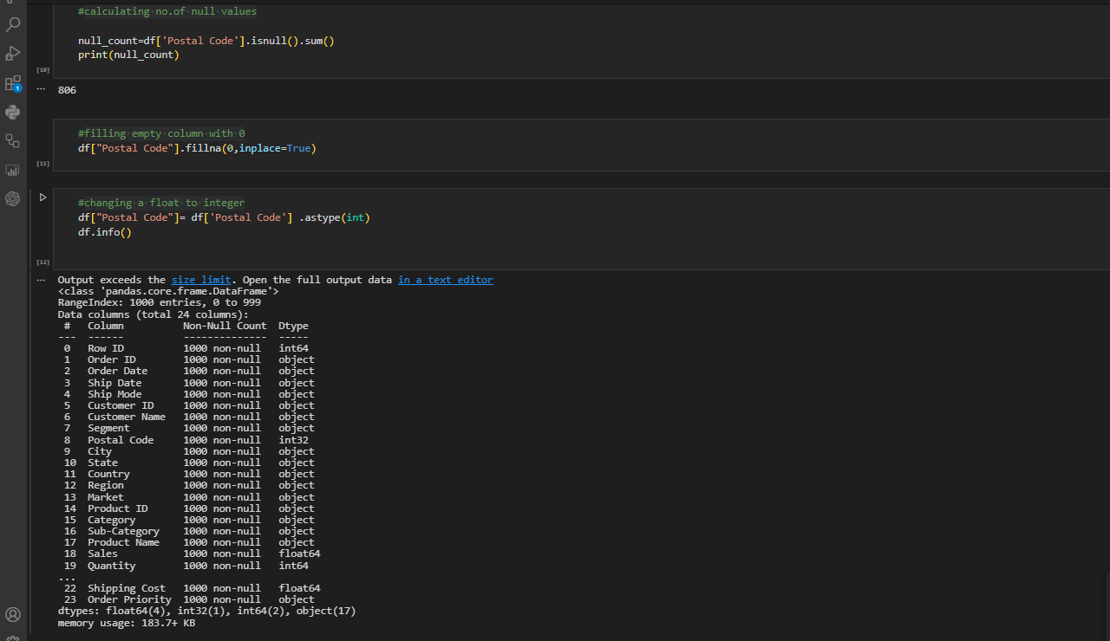
9. checking for shape of data. calculating no of nullvalues AND changing a float to integer.

Slide 11
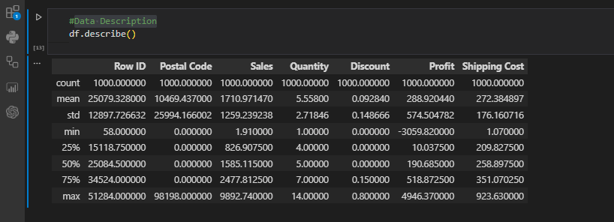
10. Data Description.

Slide 12
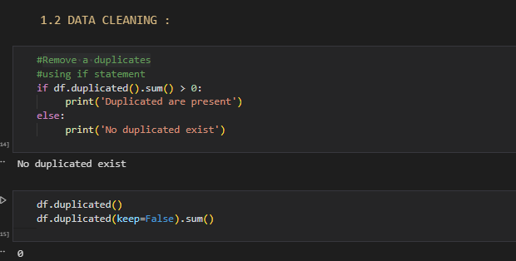
11.DATA CLEANING

Slide 13

2.CUSTOMER SEGMENTATION :

Slide 14
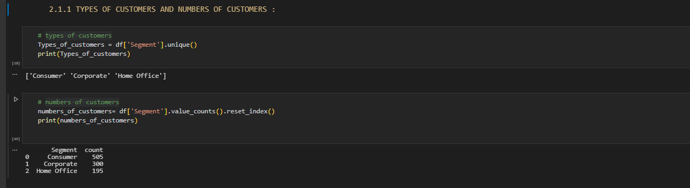
1. TYPES OF CUSTOMERS AND NUMBERS OF CUSTOMERS :

Slide 15
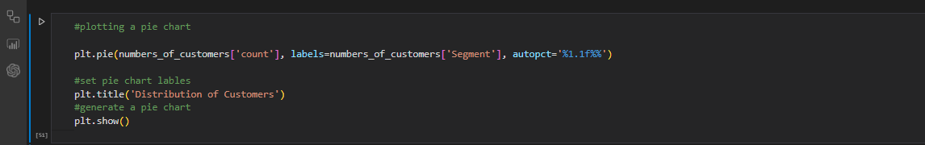
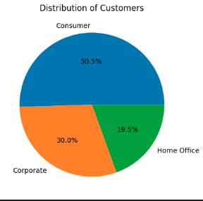
2. PLOTTING A PIE CHART :

Slide 16
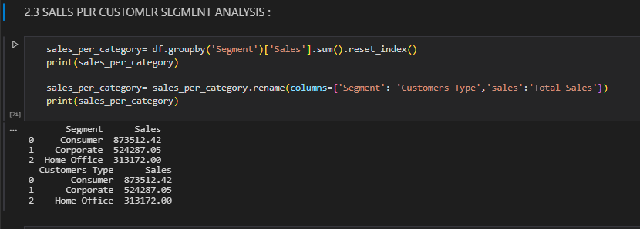
3. SALES PER CUSTOMER SEGMENT ANALYSIS :

Slide 17
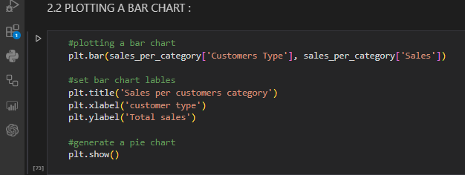
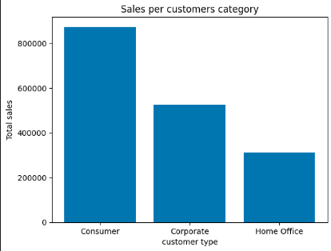
4.PLOTTING A BAR CHART :

Slide 18
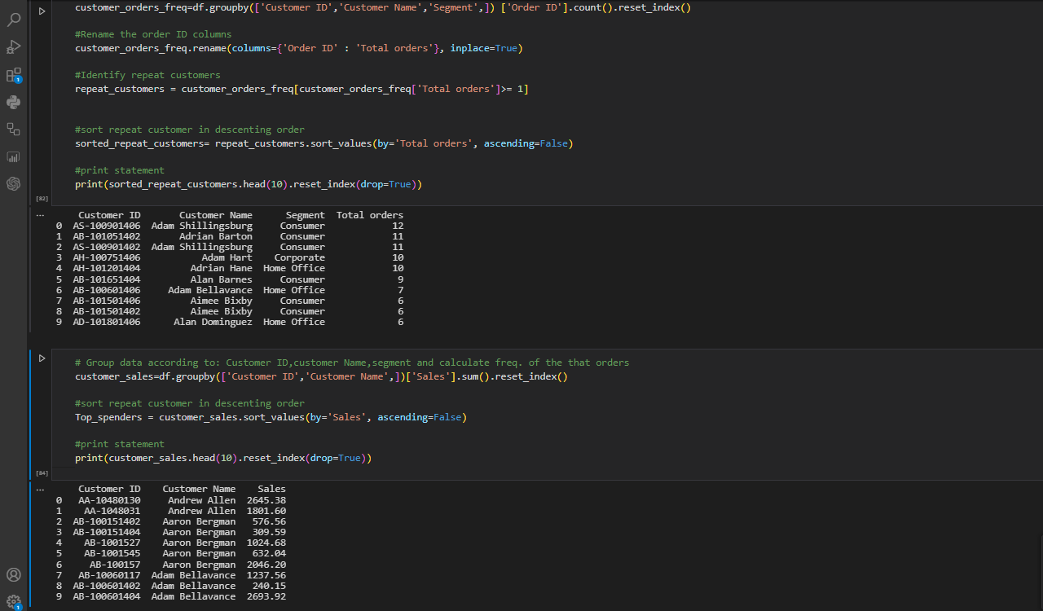
5. CUSTOMER LOYALTY ANALYSIS :

Slide 19

MODE OF SHIPPING ANALYSIS :

Slide 20
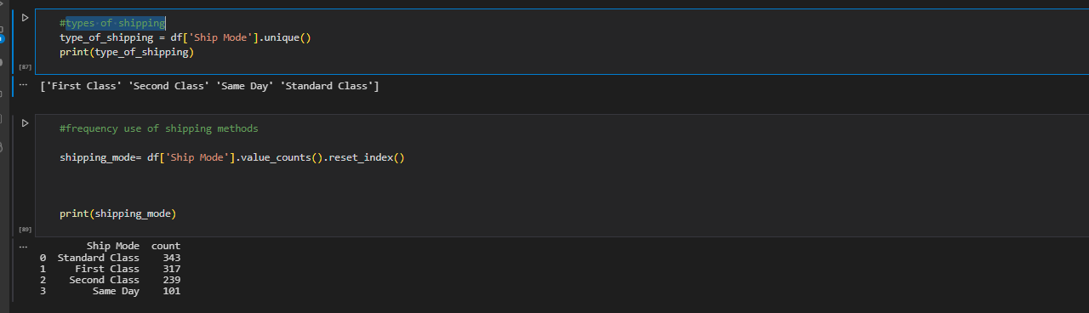
1. types of shipping :

Slide 21
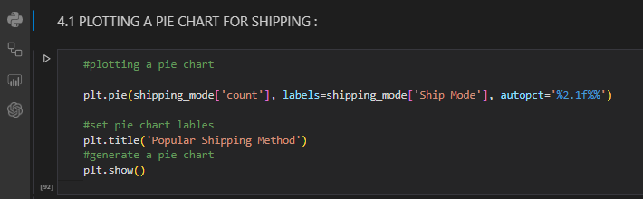
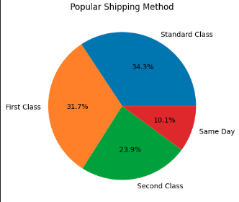
2. PLOTTING A PIE CHART FOR SHIPPING :

Slide 22

PRODUCT ANALYSIS :

Slide 23
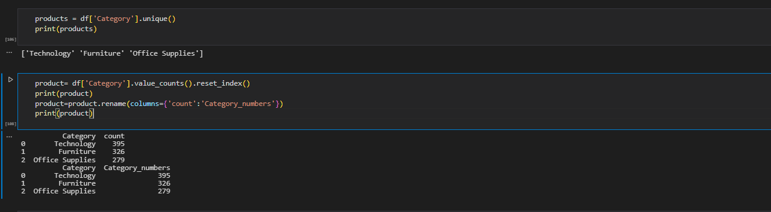
1.PRODUCT ANALYSIS:

Slide 24
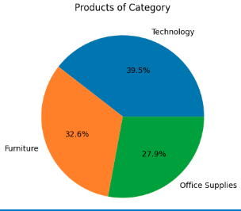
2. PLOTTING A PIE CHART FOR PRODUCT ANALYSIS:

Slide 25

SALES ANALYSIS:

Slide 26
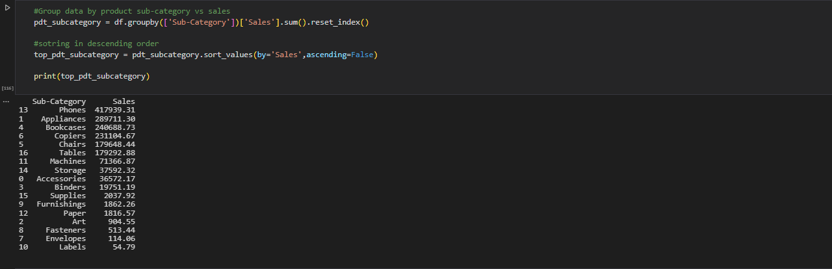
1.sub-category sales:

Slide 27
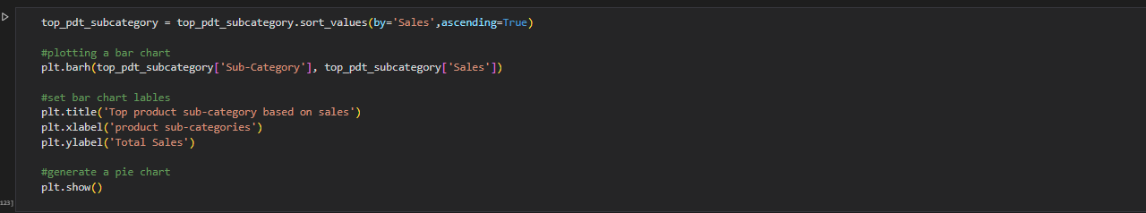
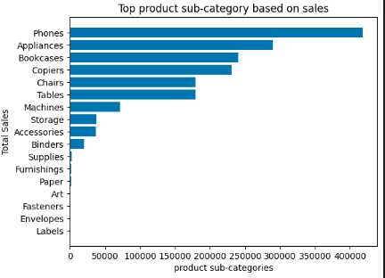
2. PLOTTING A BARH CHART FOR sub-category sales ANALYSIS:

